Slide 1
Core Java – Part 7

Slide 2
What we will cover today?
Input / Output in Java
Character & Byte Oriented I/O
Handling Files in Java
Serialization
Deserialization

Slide 3
Java IO
Process the input and produce the output.
Java uses the concept of stream to make I/O operation fast.
java.io package contains all the classes required for input and output operations.
Stream
A stream is a sequence of data.
In Java a stream is composed of bytes. It's called a stream because it is like a stream of water that continues to flow.
In java, 3 streams are created for us automatically. All these streams are attached with console.
1) System.out: standard output stream
2) System.in: standard input stream
3) System.err: standard error stream

Slide 4
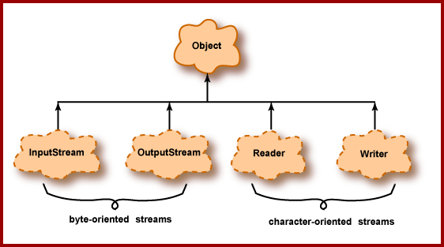
Brief Classification of I/O in Java

Slide 5
Why Byte Oriented Stream
1 byte = 8 Bits
It can read/write files containing ASCII characters that range from 0 to 255.
Meaning, it can only work with English language.
Can not work with any other language.
Why Character Oriented Stream
1 Character = 16 Bits
Character Stream operates on Unicode characters.
This can read / write files given in any language.
Can work with any other language.

Slide 6
OutputStream vs InputStream
OutputStream
Java application uses an output stream to write data to a destination, it may be a file, an array, peripheral device or socket.
InputStream
Java application uses an input stream to read data from a source, it may be a file, an array, peripheral device or socket.

Slide 7
OutputStream vs InputStream

Slide 8
OutputStream class
OutputStream class is an abstract class. It is the super class of all classes representing an output stream of bytes. An output stream accepts output bytes and sends them to some sink.

Slide 9
InputStream class
InputStream class is an abstract class. It is the super class of all classes representing an input stream of bytes.

Slide 10
Java FileOutputStream Class
Java FileOutputStream is an output stream used for writing data to a file.
For primitive values, use FileOutputStream class.
For character-oriented data, it is preferred to use FileWriter than FileOutStream.
public class FileOutputStream extends OutputStream

Slide 11
Try it
import java.io.FileOutputStream;
public class FileOutputStreamExample {
public static void main(String args[]){
try{
FileOutputStream fout=new FileOutputStream("D:\\testout.txt");
fout.write(65);
fout.close();
System.out.println("success...");
}catch(Exception e){System.out.println(e);}
}
}

Slide 12
Writing a String
import java.io.FileOutputStream;
public class FileOutputStreamExample {
public static void main(String args[]){
try{
FileOutputStream fout=new FileOutputStream("D:\\testout.txt");
String s=“Whatever I write here will get stored in a file”
byte b[]=s.getBytes();//converting string into byte array
fout.write(b);
fout.close();
System.out.println("success...");
}catch(Exception e){System.out.println(e);}
}
}

Slide 13
Java FileInputStream Class
Java FileInputStream class obtains input bytes from a file.
It is used for reading byte-oriented data (streams of raw bytes) such as image data, audio, video etc.
You can also read character-stream data.
But, for reading streams of characters, it is recommended to use FileReader class.
public class FileInputStream extends InputStream

Slide 14
Try this..
import java.io.FileInputStream;
public class DataStreamExample {
public static void main(String args[]){
try{
FileInputStream fin=new FileInputStream("D:\\testout.txt");
int i=fin.read();
System.out.print((char)i);
fin.close();
}catch(Exception e){System.out.println(e);}
}
}

Slide 15
To read all characters
import java.io.FileInputStream;
public class DataStreamExample {
public static void main(String args[]){
try{
FileInputStream fin=new FileInputStream("D:\\testout.txt");
int i=0;
while((i=fin.read())!=-1){
System.out.print((char)i);
}
fin.close();
}catch(Exception e){System.out.println(e);}
}
}

Slide 16
Java FileWriter Class
Java FileWriter class is used to write character-oriented data to a file. It is character-oriented class which is used for file handling in java.
Unlike FileOutputStream class, you don't need to convert string into byte array because it provides method to write string directly.
public class FileWriter extends OutputStreamWriter

Slide 17
Try this..
import java.io.FileWriter;
public class FileWriterExample
{
public static void main(String args[]){
try{
FileWriter fw=new FileWriter("D:\\testout.txt");
fw.write(“This will write to a file");
fw.close();
}catch(Exception e){System.out.println(e);}
System.out.println("Success...");
}
}

Slide 18
Java FileReader Class
Java FileReader class is used to read data from the file. It returns data in byte format like FileInputStream class.
It is character-oriented class which is used for file handling in java.
public class FileReader extends InputStreamReader

Slide 19
Try This…
import java.io.FileReader;
public class FileReaderExample
{
public static void main(String args[])throws Exception
{
FileReader fr=new FileReader("D:\\testout.txt");
int i;
while((i=fr.read())!=-1)
System.out.print((char)i);
fr.close();
}
}

Slide 20

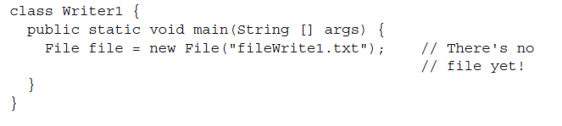
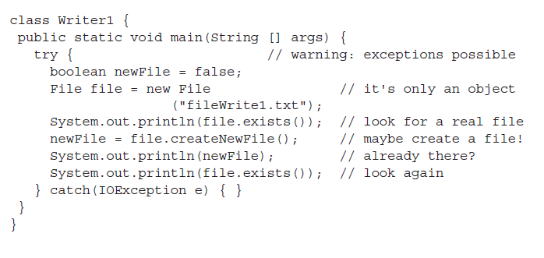
Creating a File…

Slide 21
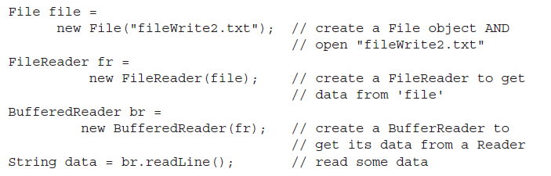
Sample BufferedReader code…

Slide 22
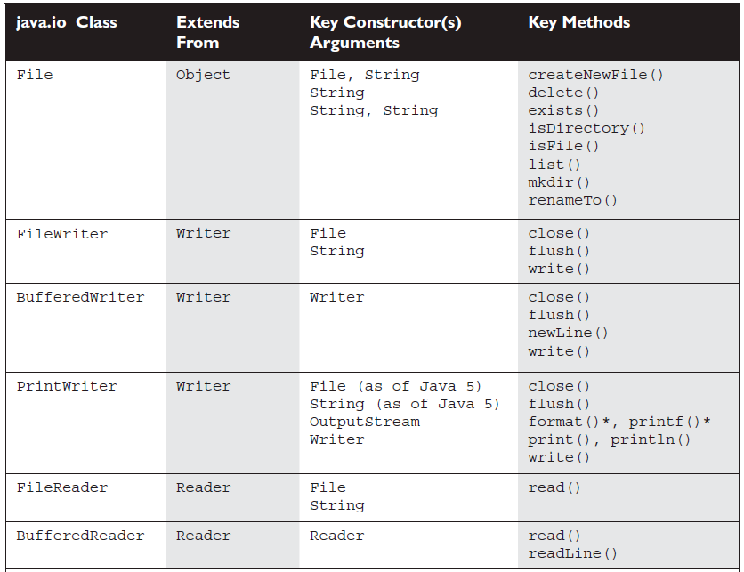

Slide 23
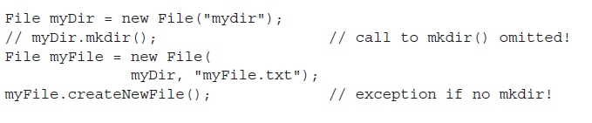
Working with directory..

Slide 24
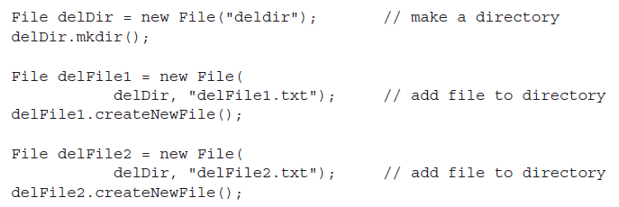
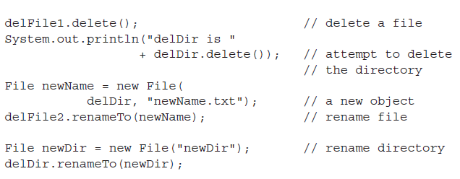
Deleting files…

Slide 25
Java Scanner class
There are various ways to read input from the keyboard, the java.util.Scanner class is one of them.
The Java Scanner class breaks the input into tokens using a delimiter that is whitespace bydefault. It provides many methods to read and parse various primitive values.
Java Scanner class is widely used to parse text for string and primitive types using regular expression.
Java Scanner class extends Object class and implements Iterator and Closeable interfaces.

Slide 26
Scanner class
Scanner class is available Java .util package
Syntax :
Scanner scanner=new Scanner(System.in);
int a=scanner.nextInt();
Float c=scanner.nextFloat();
String b=scanner.next();

Slide 27
Try this..
import java.util.Scanner;
class ScannerTest{
public static void main(String args[]){
Scanner sc=new Scanner(System.in);
System.out.println("Enter your rollno");
int rollno=sc.nextInt();
System.out.println("Enter your name");
String name=sc.next();
System.out.println("Enter your fee");
double fee=sc.nextDouble();
System.out.println("Rollno:"+rollno+" name:"+name+" fee:"+fee);
sc.close();
}
}

Slide 28
Persistence
Saving data to some type of permanent storage is called persistence.
An object that is persistent-capable, can be stored on disk (or any other storage device), or sent to another machine to be stored there.
A non persisted object exists only as long as the Java Virtual Machine is running.
Java serialization is the standard mechanism for saving an object as a sequence of bytes that can later be rebuilt into a copy of the object.
To serialize an object of a specific class, the class must implement the java.io.Serializable interface.
The java.io.Serializable interface is a marker interface defines no methods, and serves only as a marker to indicate that the class should be considered for serialization.

Slide 29
Serialization and Deserialization in Java
Serialization is a process of converting an object into a sequence of bytes which can be persisted to a disk or database or can be sent through streams. The reverse process of creating object from sequence of bytes is called deserialization.
A class must implement Serializable interface present in java.io package in order to serialize its object successfully.
Serializable is a marker interface that adds serializable behaviour to the class implementing it.

Slide 30
Signature of writeObject() and readObject()
writeObject() method of ObjectOutputStream class serializes an object and send it to the output stream.
public final void writeObject(object x) throws IOException
readObject() method of ObjectInputStream class references object out of stream and deserialize it.
public final Object readObject() throws IOException,ClassNotFoundException
while serializing if you do not want any field to be part of object state then declare it either static or transient based on your need and it will not be included during java serialization process.

Slide 31
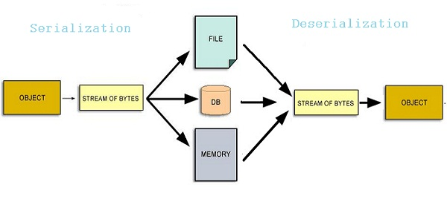
Continued..
The String class and all the wrapper classes implements java.io.Serializable interface by default.

Slide 32
Try this..(Serializing an Object)
import java.io.*;
public class Student implements Serializable
{
String name;
int rid;
static String contact;
Student(String n, int r, String c)
{
this.name = n;
this.rid = r;
contact = c;
}
public static void main(String[] args)
{
try
{
Student si = new Student("Abhi", 104, "110044");
FileOutputStream fos = new FileOutputStream("student.ser");
ObjectOutputStream oos = new ObjectOutputStream(fos);
oos.writeObject(si);
oos.close();
fos.close();
}
catch (Exception e)
{ e. printStackTrace(); }
}
}

Slide 33
Deserialization of Object
public static void main(String[] args)
{
Student si=null ;
try
{
FileInputStream fis = new FileInputStream("student.ser");
ObjectInputStream ois = new ObjectInputStream(fis);
si = (Student)ois.readObject();
}
catch (Exception e)
{ e.printStackTrace(); }
System.out.println(si.name);
System.out. println(si.rid);
System.out.println(si.contact);
}
}

Slide 34
transient Keyword
While serializing an object, if we don't want certain data member of the object to be serialized we can mention it transient. transient keyword will prevent that data member from being serialized.
class studentinfo implements Serializable
{
String name;
transient int rid;
static String contact;
}
Making a data member transient will prevent its serialization.
In this example rid will not be serialized because it is transient, and contact will also remain unserialized because it is static.

Slide 35

Any Question ?

Slide 36

Thank you !

